Slide 1
Software Design and Architecture
Domain Model

Slide 2
Domain Model
A domain model, or Domain Object Model (DOM) is a conceptual model of a domain of interest (often referred to as a problem domain)
which describes the
  various entities,
  their attributes and
  Relationships.

Slide 3
Point of Sale: Case Study
The Point-of-Sale terminal is a computerized system used to record sales and handle payments; it is typically used in a retail store.
It includes hardware components such as a computer and bar code scanner, and software to run the system.

Slide 4
POS
A product catalogue maintains the list of products including the product description, price and code.
Manager can start a transaction initiated by a customer. Each transaction records a sale whereas a sale is comprised of date, time, product and payment.
Sales line item shows sale of any item of the product.
The cashier keeps a record of the total sales of the store.

Slide 5
How to represent entities?
A Domain Model is used to represent entities and it illustrates meaningful concepts in a problem domain.
It is a representation of real-world things, not software components.

Slide 6
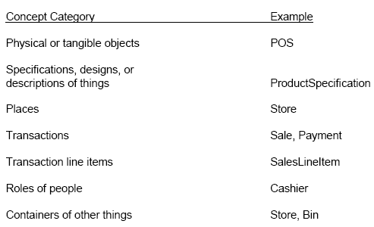
Concept Category List

Slide 7
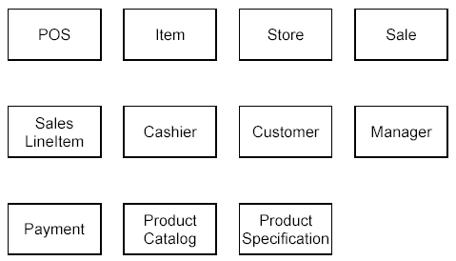
Example: POS

Slide 8
Identify Attributes
An attribute is a logical data value of an object.
  For example, a Sales receipt normally includes a date and time.
  The Sale concept would need a date and time attribute.

Slide 9
Attributes …
Keep attributes simple.
  The type of an attribute should not normally be a complex domain concept, such as Sale or Airport.
Attributes in a Domain Model should preferably be
  Pure data values: Boolean, Date, Number, String, …
  Simple attributes: color, phone number, zip code, universal product code (UPC), ...

Slide 10
Identify Entity Relations
The relationships between the entities identified earlier are known as associations.
An association is a relationship between concepts that indicates some meaningful and interesting connection.
Associations can be named.

Slide 11
Part-of-speech Analysis
Part of speech Model component Example
Proper noun object Jim Smith
Improper noun class man
Doing verb method buy, recommend
being verb inheritance is-a (kind-of)
having verb aggregation has an
modal verb constraint must be
adjective attribute 3 years old
transitive verb method enter
intransitive verb method (event) depends on

Slide 12
Creating a Domain Model
List the candidate conceptual classes based on the requirements
Draw them in a domain model
Add associations necessary to record relationships
Add attributes to meet information requirements

Slide 13
Point of Sale: Case Study
The Point-of-Sale terminal is a computerized system used to record sales and handle payments; it is typically used in a retail store.
It includes hardware components such as a computer and bar code scanner, and software to run the system.

Slide 14
POS
A product catalogue maintains the list of products including the product description, price and code.
Manager can start a transaction initiated by a customer. Each transaction records a sale whereas a sale is comprised of date, time, product and payment.
Sales line item shows sale of any item of the product.
The cashier keeps a record of the total sales of the store.

Slide 15
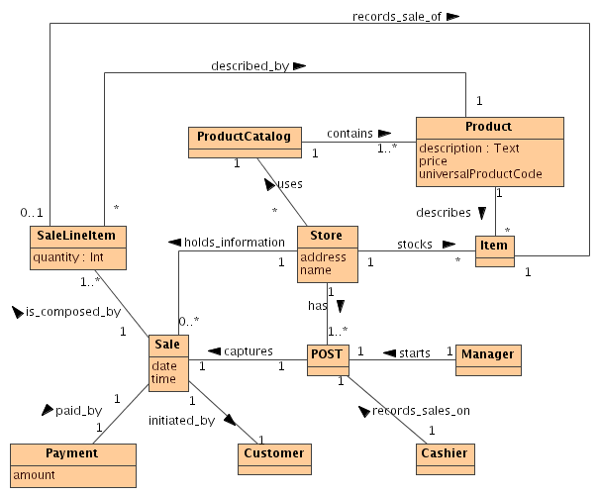
Putting it all together: POS Class Diagram

